Slide 1
Chapter 2
Matrix Algebra

Slide 2
Contents
2.1 Matrix Addition, Scalar Multiplication, and Transposition
2.2 Matrix Multiplication (2.3 7e)
2.3 Matrix Inverses (2.4 7e)
2.5 Matrix Transformations (2.2 & 2.6 7e)
2.7 An Application to Input-Output Economic Models (2.8 7e)

Slide 3
Objectives
Practicing some matrix operations
Find matrix inverse
Using matrix transformations to reveal the geometrical meaning of matrix multiplication and inverse.
The relationship of matrix algebra to linear equations
Application to Input – Output Economic Models

Slide 4
2.1. Matrix Addition, scalar multiplication and transposition

Slide 5
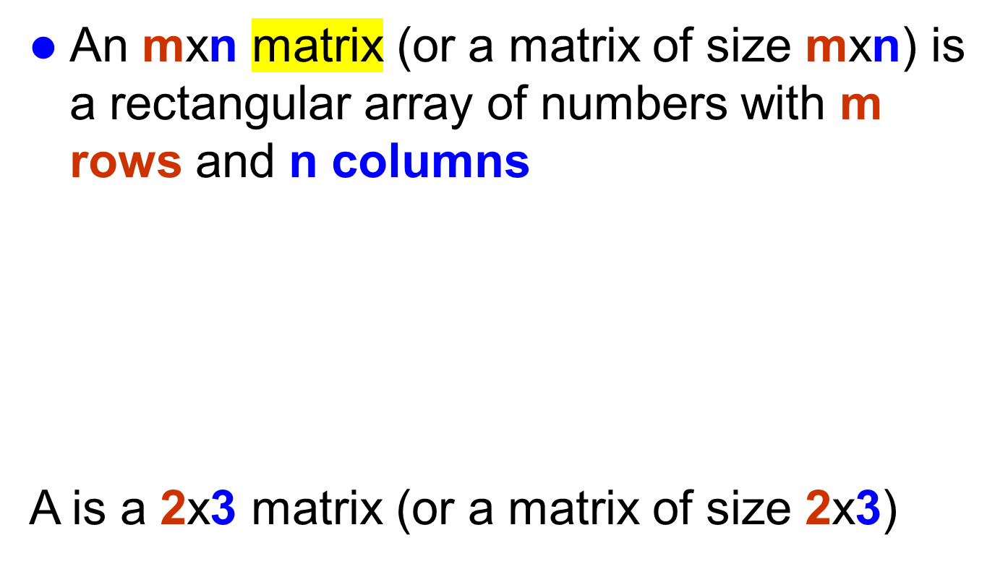
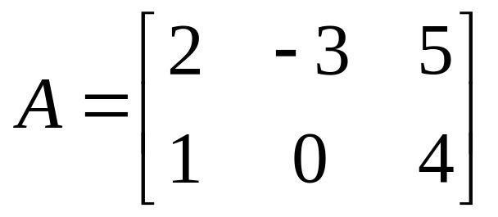
Definitions
3 columns
the (1,3)-entry of A
2 rows

Slide 6

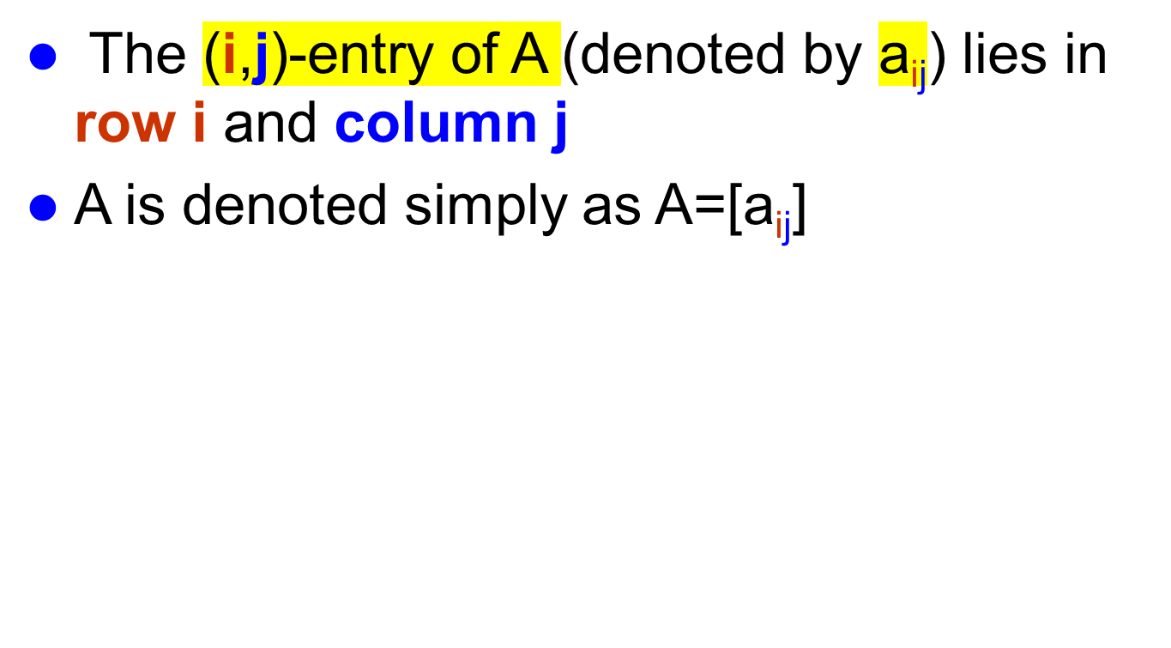
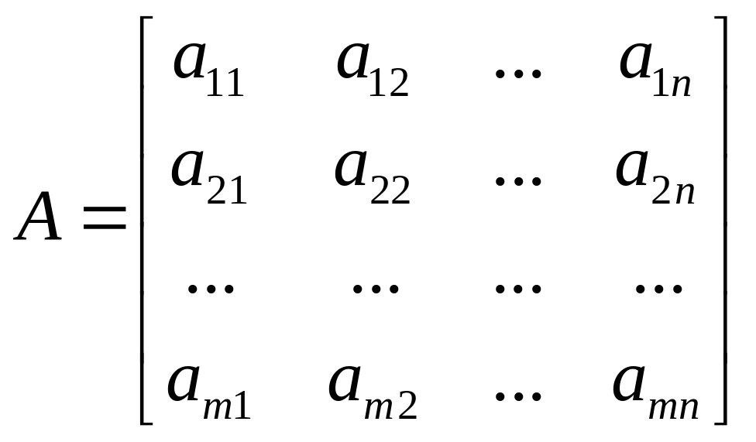
2 refers to the row
n refers to the column

Slide 7
Definitions
An mxm matrix is called a square matrix (ma trận vuông) of size m
The zero matrix (ma trận không) of size mxn ( denoted by (0_{mxn})is the matrix that its all entries are 0
If A=[a_{ij}] is an mxn matrix then -A refers to the negative matrix (ma trận đối) of A and defined by
-A=[-a_{ij}]

Slide 8
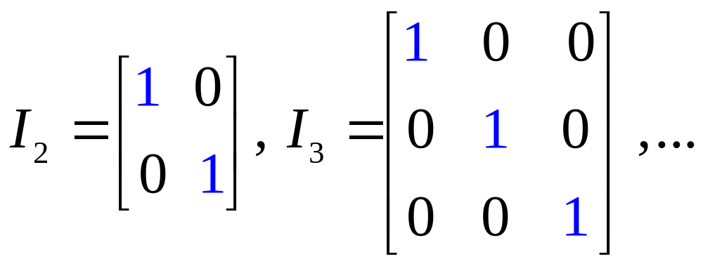
Identity matrices (ma trận đơn vị)
An identity matrix I is a square matrix with 1’s on the
main diagonal and zeros elsewhere

Slide 9
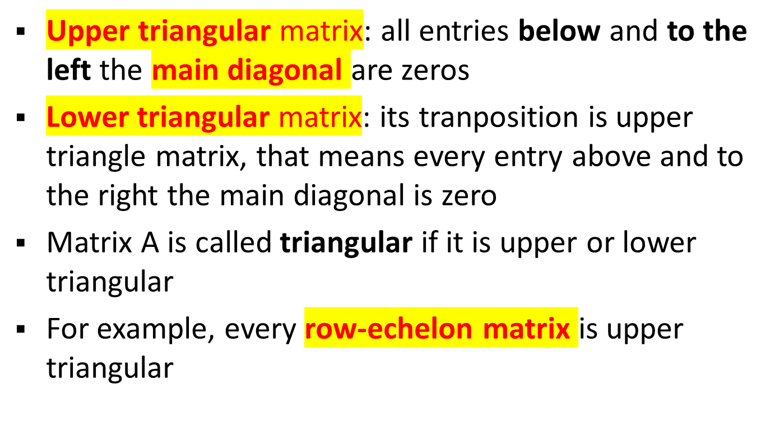
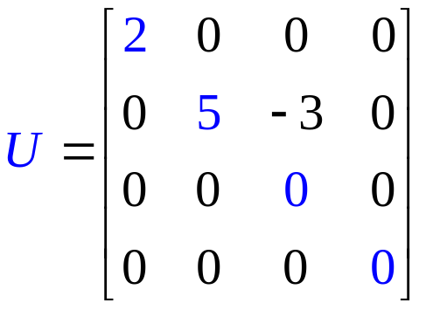
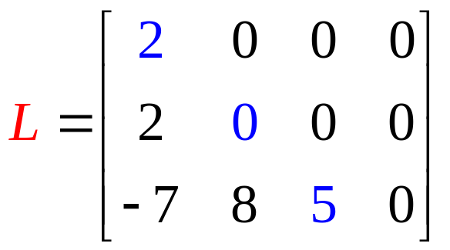
Triangular matrices

Slide 10
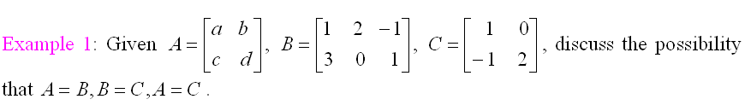
Two matrices are called equal if
They have the same size
Corresponding entries are equal
If A=[a_{ij}], B=[b_{ij}] then A=B means a_{ij}=b_{ij} for all i and j

Slide 11
Matrix Addition of same size matrices
If A=[a_{ij}], B=[b_{ij}] then the sum matrix A+B is defined by A+B=[a_{ij}+b_{ij}]
The difference A-B is a matrix defined by
A-B=A+(-B)=[a_{ij}-b_{ij}] for all mxn matrices A and B
Note that A-A=0, A+0=A (0 is zero matrix) for all mxn matrix A
Notes:
Addition is NOT defined for matrices of different sizes.

Slide 12
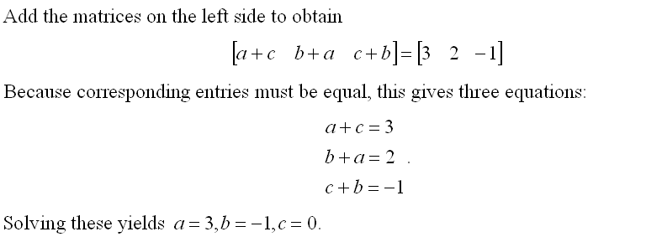


Slide 13
Properties
If A ,B and C are any matrices of the same size, then
A+B=B+A (commutative law: giao hoán)
A+(B+C)=(A+B)+C (associative law: kết hợp)

Slide 14

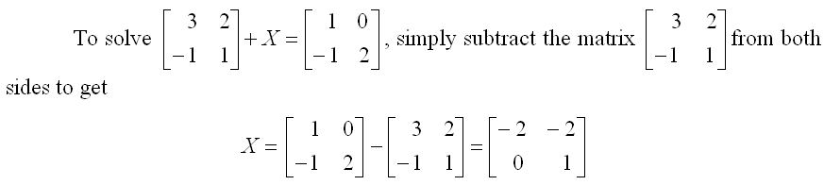

Slide 15
Scalar Multiplication
(phép nhân vô hướng)
Suppose A=[a_{ij}] is an mxn matrix and k is a real munber, the scalar multiple kA is a matrix defined by kA=[ka_{ij}]
kA=0→ (either k=0 or A=0)
(k=0 or A=0)→kA=0
Scalar: a quantity that has magnitude, but not direction; -- distinguished from a vector, which has both magnitude and direction (Webster Dictionary) → One value
Notes:
If A is any matrix, kA is the same size as A for all scalars k.

Slide 16
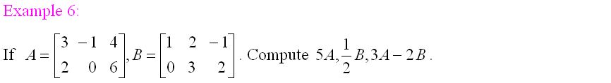
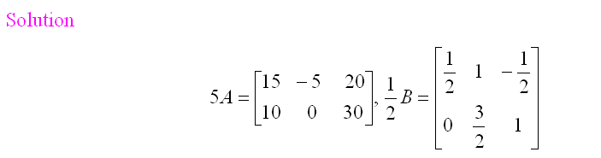

Slide 17
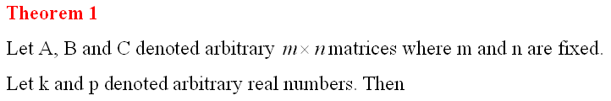
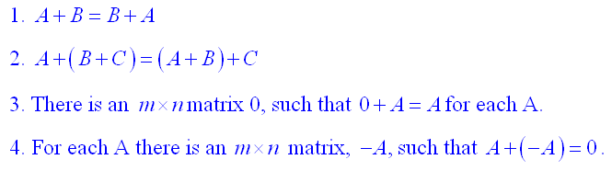



Slide 18
Transpose
If A=[a_{ij}] is any mxn matrix,the transpose of A, written A^{T}, is an nxm matrix defined by A^{T}=[a_{ji}]
The row i of A is the column i of A^{T}
The column j of A is the row j of A^{T}

Slide 19
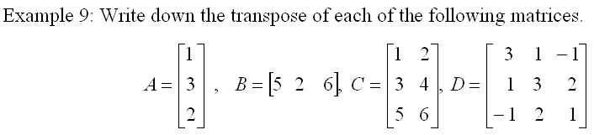
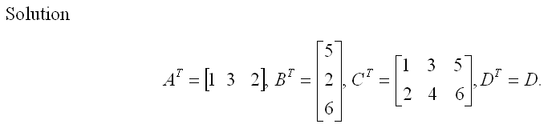

Slide 20
Theorem 2
(A^{T})^{T}=A
(kA)^{T}=k(A^{T})
(A+B)^{T}=A^{T}+B^{T}

Slide 21
Definitions
If A=[a_{ij}] is any mxn matrix, then a₁₁,a₂₂,a₃₃,…, are called the main diagonal (đường chéo chính) of A
If A=A^{T} then A is called symmetric (đối xứng). In this case, A is a square matrix

Slide 23
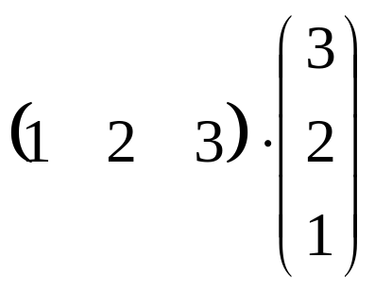

Dot product (tích vô hướng)
Example

Slide 24
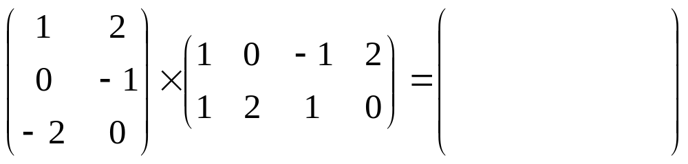
2.2 Matrix Multiplication
Suppose A=[a_{ij}] is an mxk matrix and B=[b_{ij}] is an kxn matrix, then the product AB=[c_{ij}] is an mxn matrix whose the (i,j)-entry is the dot product of row i of A and column j of B
c_{ij}=(row i of A).(column j of B)
Note that A_{mxk}B_{kxn} is a mxn matrix
1.1+2.1
3
4
1
2
3
4
1
2
-1
-2
-1
0
-1
-2
-1
0
-2
0
2
-2
0
2
-4
Notes:
1.To find AB, first you sure that the number of columns of A is equals to the number of rows of B, then determine size of AB.
2. AB ≠BA (general).

Slide 25
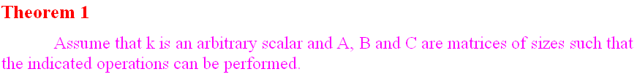
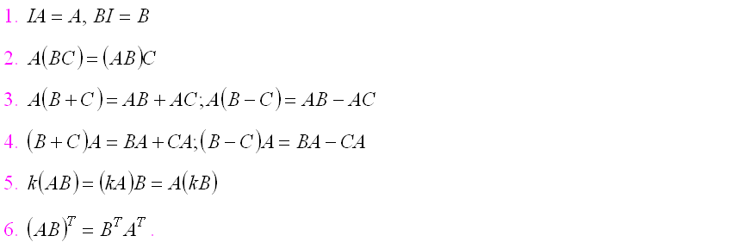

Slide 26
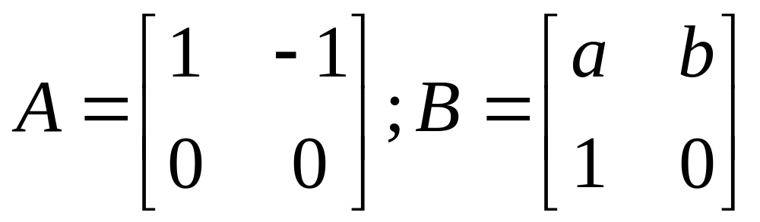
Example
Find B such that:
B commutes with A
B² is zero matrix

Slide 27
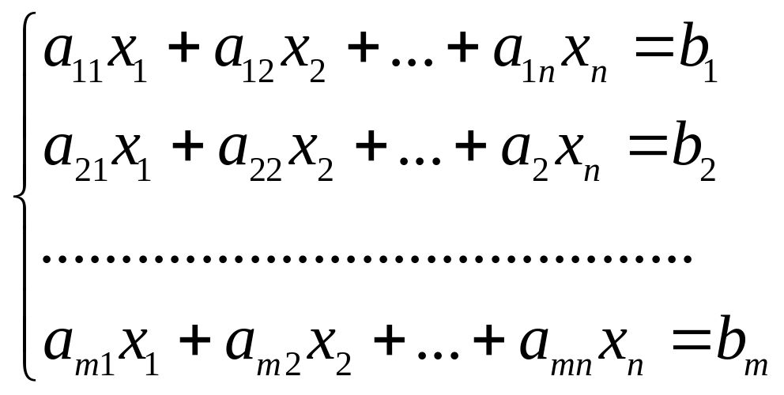
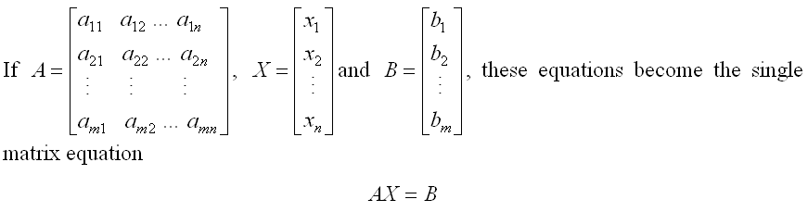
Matrix and system of linear equations
Consider the system

Slide 28
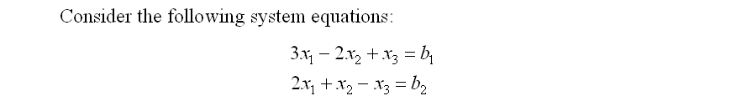
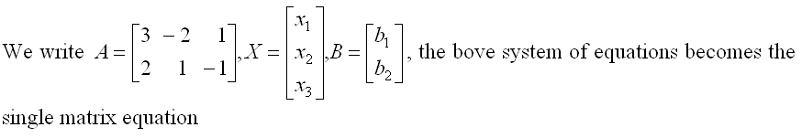


Slide 29
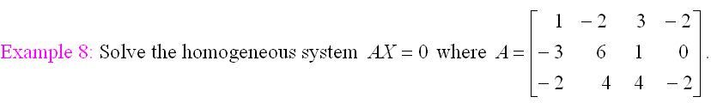
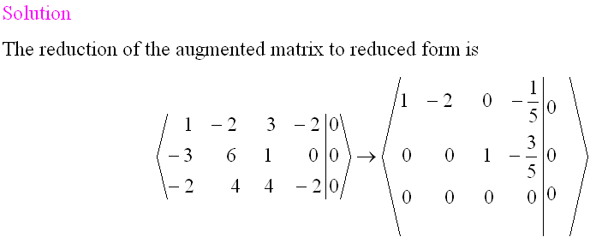
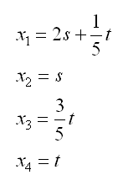


two parameters

Slide 30
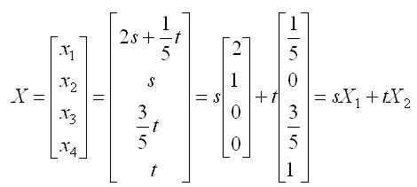
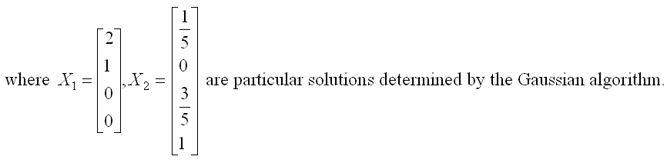
linear combination of X₁,X₂
basic solutions

Slide 31
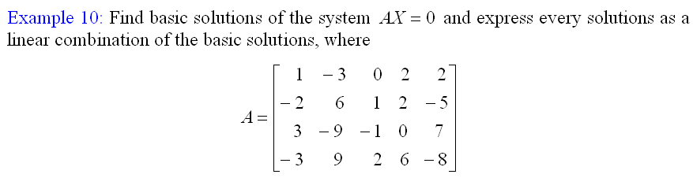

Slide 32

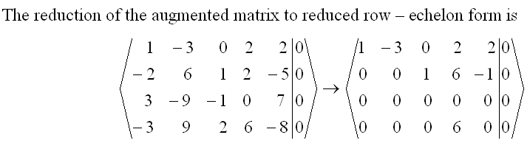
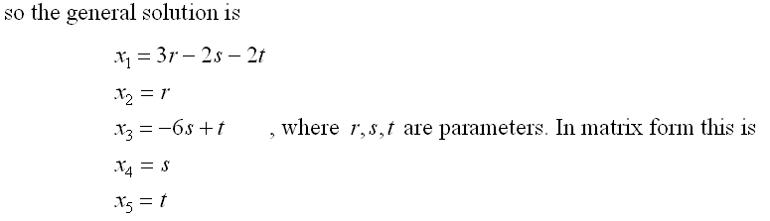
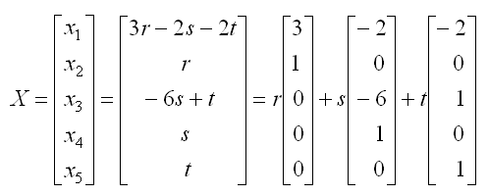
basic solutions

Slide 33
Theorem 3
Let A be an mxn matrix of rank r, AX=0 is an homogeneous in n variables. Then:
The system has exactly n-r basic solutions, one for each parameter.
Every solution is a linear combination (tổ hợp tuyến tính) of these basic solutions.
basic solutions
linear combination

Slide 34
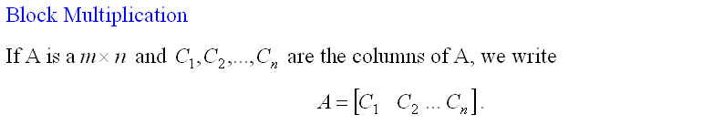
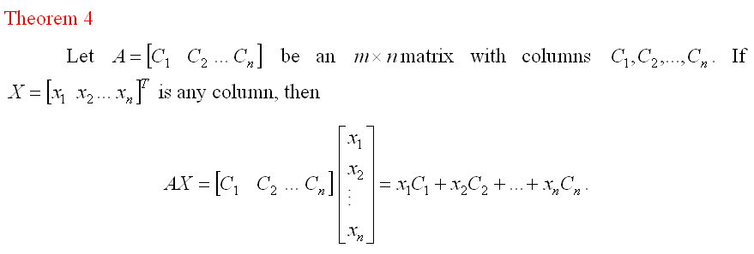
Notes:
Block multiplication is useful in computing products of matrices in a computer with limited memory capacity. The matrices are partitioned into blocks in such a way that each product of blocks can be handled.

Slide 35
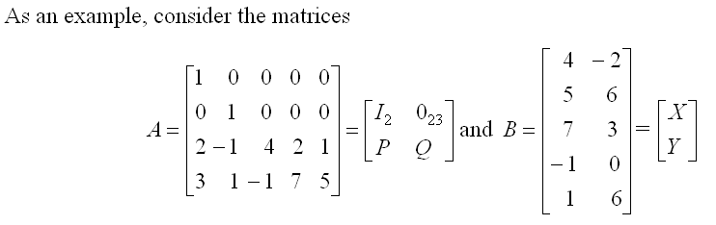
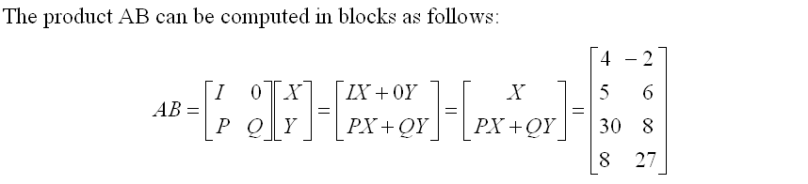

Slide 36
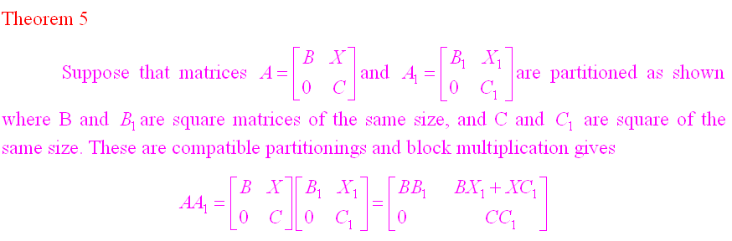

Slide 37
Exercises 16a,18a p49

Slide 38
Directed Graph
Points=vertices
Vertices are connected by arrows called edges
If a directed graph has n vertices v₁,v₂,…,v_{n}, the adjacency matrix A=[a_{ij}] is the nxn matrix
The (i,j)-entry is only 1 or 0
If there is an edge from v_{j} to vertex v_{i} then a_{ij}=1 else a_{ij}=0

Slide 39
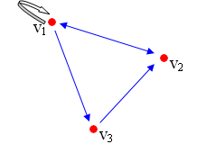
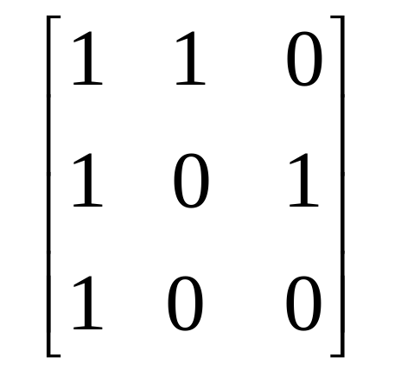
Directed Graph
a₁₁=1 means v₁→v₁
a₂₃=1 means v₃→v₂
a₃₂=0 means have no edges from vertex 2 to vertex 3
A path of length r (or an r-path) from vertex j to vertex i is a sequence of r edges leading from v_{j} to v_{i}.
v₁→v₂→v₁→v₃→v₂ is a 4-path from v₁ to v₂

Slide 40
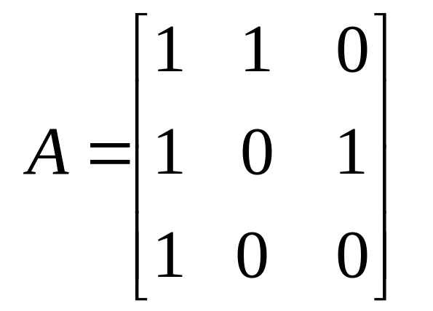
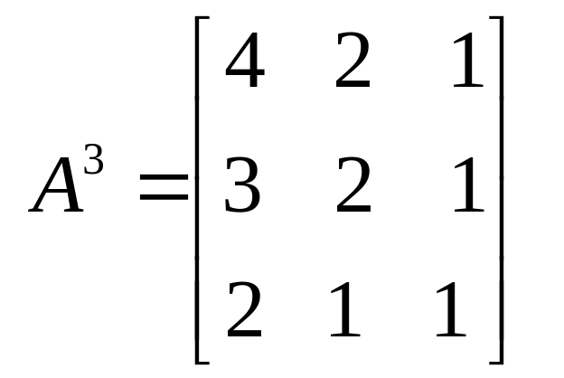
Theorem 6
If A is the adjacency matrix of a directed graph with n vertices, then the (i,j)-entry of A^{r} is the number of r-paths v_{j}→v_{i}
For example, in A³, (2,1)-entry is 3, so there are three 3-paths from v₁ to v₂
There are one 3-paths from v₂ to v₃ as (3,2)-entry of A³ is 1

Slide 41
2.3 Matrix Inverse

Slide 42
Definition
If A is a square matrix, a matrix B is called an inverse (nghịch đảo) of A if and only if AB=I and BA=I
A matrix A that has an inverse is called an invertible (khả nghịch) matrix.

Slide 43
Ex. Suppose B and C are both inverses of A. Show that B=C
B.A=A.B=I, C.A=A.C=I (supposition)
B=…=C (our goal)
B=I.B=(C.A).B=C.(A.B)=C.I=C

Slide 44
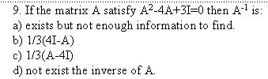

Slide 45
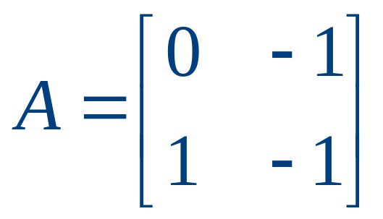
Example
Show that A³=I and find A⁻¹ if
Solve the system AX=B with B=[1 2]^{T}

Slide 46
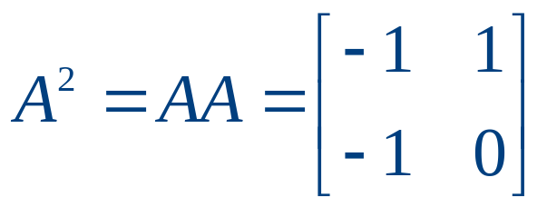
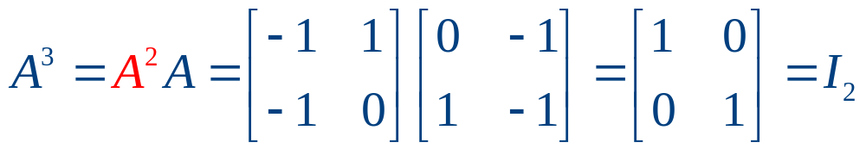
Example
We have
And, A³= A²A=AA²=I₂
So, A⁻¹=A²

Slide 47
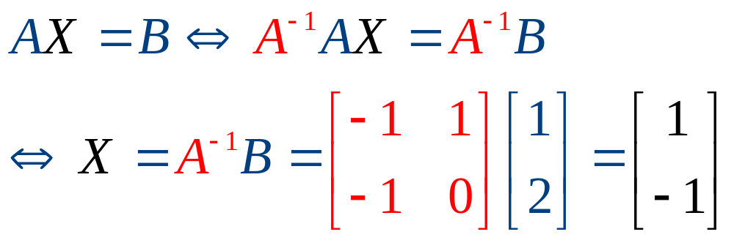
Example

Slide 48
Theorem 2
Suppose AX=B is a system of n equations in n variables and A is an invertible matrix. Then the system has the unique solution
X=A⁻¹B

Slide 49
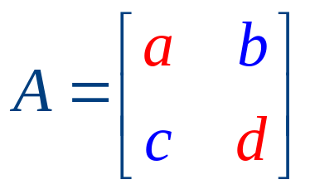


The inverse of an 2x2 matrix
Consider the matrix
The determinant of A is detA=ad-bc
The adjugate matrix of A is defined by

Slide 50





The inverse of 2x2 matrix
If
then

Slide 51




Find the inverse of the following matrices

Slide 52

Matrix Inversion Algorithm
input
output
Theorem 3.
Either any square matrix can be reduced to I or not.
In the first case, the algorithm produces A⁻¹;
in the second, A⁻¹ does not exist.

Slide 53

Example
Find the inverse of the matrix

Slide 54



Example

Slide 55


Example
Notes:
Get a extra example that matrix is not invertible.

Slide 56
Properties
Theorem 4
(A⁻¹)⁻¹=A
(AB)⁻¹=B⁻¹A⁻¹
(A^{T})⁻¹=(A⁻¹)^{T}
(A₁A₂…A_{k})⁻¹=A_{k}⁻¹…A₂⁻¹A₁⁻¹
(A^{k})⁻¹=(A⁻¹)^{k}
(aA)⁻¹=A⁻¹/a
I⁻¹=I
Corollary. A square matrix A is invertible iff A^{T} is invertible

Slide 57


Example
Find A if

Slide 58
Theorem 5
The following conditions are equivalent for an nxn matrix A
1. A is invertible
2. The homogeneous system AX=0 has only the trivial solution X=0
3. A can be carried to I_{n} by elementary row operations
4. The system AX=B has unique solution for every choice of column B
5. There exist an nxn matrix C such that AC=I_{n}

Slide 59
Corollary
If A and C are square matrices such that AC=I, then also CA=I. In particular, both A and C are invertible, C=A⁻¹ and A=C⁻¹ (since 5→1)

Slide 60
2.5. Matrix Transformations
(phép biến đổi ma trận)

Slide 61

Definitions
(a₁,a₂,…,a_{n}): ordered n-tuple
R^{n}: the set of all ordered n-tuples
Every (a₁,a₂,…,a_{n}) in R^{n} is called a vector or n-vector

Slide 62

Transformations
R^{n}
R^{m}
X
T
T(X)
Two transformations T and S are called equal iff
T(X)=S(X) , for all X in R^{n}

Slide 63



Transformations

Slide 64

Formula of the Transformation
T[x₁ x₂ x₃]^{T}=[x₁ x₁-x₂ x₂-x₃ x₃-x₁]^{T} defines a transformation T:R³→R⁴
Suppose A is an mxn matrix, then
T[x₁ x₂ … x_{n}]^{T}=A[x₁ x₂ … x_{n}] ( T(X)=AX ) is a transformation T: R^{n}→R^{m} called the matrix transformation induced by A
A is zero matrix: the zero transformation T=0
A is identity matrix I_{n}: the identity transformation T=

Slide 65


Transformation induced by a matrix A
Matrix Multiplication (T)
X
T(X)=AX
Matrix transformation induced by A
T(X)=0X=0
T(X)=IX=X

Slide 66



Example
T(X)=AX

Slide 67



Example
a>1:X-expansion of R²
0<a<1:X-compression of R²
b>1:Y-expansion of R²
0<b<1:Y-compression of R²

Slide 68


Example
a>0: Positive X-shear of R²
a<0: Negative X-shear of R²

Slide 69


Example
R_{θ}: the matrix transformation that rotates R² counterclockwise (ngược chiều KĐH) about the origin through the angle θ

Slide 70


Example
The rotation of R³ about the Z axis through an angle θ from the X axis to Y axis

Slide 71

Translation
There are transformation that are not matrix transformations
For example, the translation ( phép tịnh tiến) is not a matrix transformation
A fixed vector
X
T
X+Y
A fixed vector
The matrix does not exist if Y is not zero vector

Slide 72
Linear Transformation
T: R^{n}→R^{m} is called a linear transformation ( phép biến đổi tuyến tính) if it satisfies:
1.T(X+Y)=T(X)+T(Y) for all vectors X and Y
2.T(aX)=aT(X) for all vector X and all scalar a
If T is a linear transformation then
T(0)=0
T(-X)=-T(X)

Slide 73
Linear Combination
(tổ hợp tuyến tính)
Y=a₁X₁+a₂X₂+…+a_{n}X_{n} is called a linear combination of vectors X₁,X₂,…,X_{n}
Theorem 1. If T: R^{n}→R^{m} is linear transformation, then
T(a₁X₁+a₂X₂+…+a_{n}X_{n})
= a₁ T(X₁)+a₂T(X₂)+…+a_{n}T(X_{n}) for all vectors X_{i}, and all scalar a_{i}

Slide 74



Linear transformation
Let T:R²→R² be linear such that
Find

Slide 75


Slide 76


Linear transformation
Example

Slide 77
How to find the matrix of an linear transformation?
Theorem 2. Let T: R^{n}→R^{m} be a transformation
1. T is linear iff it is a matrix transformation
2. If T is linear, then T is induced by a unique matrix A, given in terms of its columns by A=[T(E₁) T(E₂) … T(E_{n})] where E₁, E₂,…, E_{n} is the standard basis of R^{n}

Slide 78


Linear transformation
Example
Let T:R²→R² be linear such that
Find the matrix of T and find

Slide 79



Example
Standard basis of R²

Slide 80


Example

Slide 81
Composition
T:R^{n}→R^{m} and S:R^{m}→R^{k}
The composite of S and T is a transformation defined by (S°T)(X)=S[T(X)] for all vector X in R^{n}
Theorem 3. If T and S are linear then S°T is also linear. And if S has matrix A and T has matrix B, then S°T has matrix AB
Transformation
S
T
S°T
Matrix
A
B
AB

Slide 82

Example
The reflection in the X axis followed by rotation through pi/2 is reflection in the line y=x (ex. 9 p.78)

Slide 83

Inverse
T:R^{n}→R^{n} is a transformation that has matrix A
Suppose A is invertible then there exist A⁻¹
Let T’:R^{n}→R^{n} is a transformation that has matrix A⁻¹
T’[T(X)]=A⁻¹[AX]=IX=X
T[T’(X)]=A[A⁻¹X]=IX=X
T’ is called an inverse of T if

Slide 84
Inverse
Theorem 5. Let T:R^{n}→R^{n} denote a linear transformation with matrix A. Then A is invertible if and only if T has an inverse. In this case, T is has exactly one inverse ( which we denote as T⁻¹) and T⁻¹ has matrix A⁻¹
T
matrix A
X Y
X Y
T⁻¹
matrix A⁻¹

Slide 85


Linear transformation
Example
Let T:R²→R² be a linear such that
Find the matrix of T and find

Slide 86


Example

Slide 87


A primitive society has three basic needs: food, shelter and clothing. There are thus three industries in the society – the farming, housing and garment industries – that produce these commodities. Each of these industries consumes a certain proportion of the total output of each commodity according to the following table.
2.7 An application to Input – Output Economic Models
Find the annual prices that each industry must charge for its income to equal its expenditures.
Notes:
Primitive: nguyên thủy; annual: hàng năm; charge: tiền phải trả; expenditure: phí tổn

Slide 88


E: stochastic matrix
EP=P or (I-E)P=0 : equilibrium condition
The solutions P: equilibrium price structures
Notes:
P: mtran can bang giá.
In matrix E, the sum of entries on a column is 1.

Slide 89
Example
A town has two industries, A1 and A2. Industry A1 uses 40% of its own output with the rest used by A2, while A1 and A2 each use 50% of the output of A2. The first row of the input-output matrix, and the equilibrium price structure for these industries is:
a | [0.4 0.5], [5/11 6/11]^{T}
b | [0.4 0.6], [6/11 5/11]^{T}
c | [0.5 0.5], [4/11 7/11]^{T}
d | [0.6 0.4], [7/11 4/11]^{T}
e | All of other choices are wrong

Slide 90
Thanks

